Slide 1


ECMWF BRIEFING
14 NOVEMBER 2023
RDTD TRAINING ROOM

Slide 2


ITEMS FOR DISCUSSION
ECMWF Subscription
ECMWF data repository and retrieval
Post Processing, visualization and data archive
Repository of ECMWF Products
Post processing and visualization
Action Items/ Next Steps

Slide 3

ECMWF OVERVIEW
The European Centre for Medium-Range Weather Forecasts (ECMWF) core mission is to produce numerical weather forecasts and monitor the Earth system, carry out scientific and technical research to improve forecast skill, and maintain an archive of meteorological data.
ECMWF produces operational ensemble-based analyses and predictions that describe the range of possible scenarios and their likelihood of occurrence. It also provides world-leading weather forecasts, specialist software and one of the largest meteorological data archives in the world.

Slide 4

REASON TO APPLY FOR A LICENSE
To have an access (direct) to high resolution Ensemble Prediction System (EPS) gridded and charts.
To derive probabilistic products based on specified threshold.
To initialize storm surge and flood models.
To support day-to-day weather forecasting operations including Sub-to-Seasonal (S2S).
To reduced reliance to third-party applications in accessing NWP (ECMWF) products.
Access to high-resolution products

Slide 5
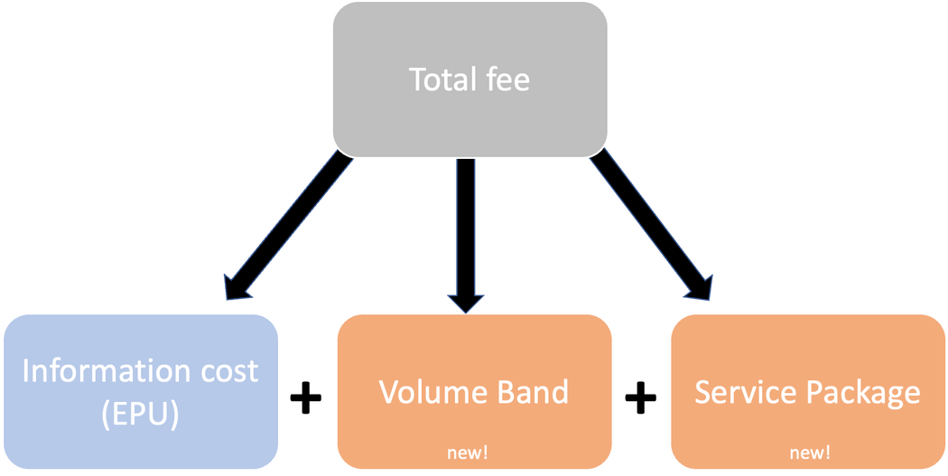
COST
COST = 20,000 EUR ( ~ 1.2 - 1.3 MILLION PHP) PER YEAR
Total daily volume (current order) | 50-100GB per day
Volumen Band (Annual) | Up to 36, 500 GB (Volume Band 4)
Package | GOLD
 | Inclusions: MARS ecCHarts Unlimited (4x) changes to operational data requirements per year by the users (ECMWF) 24/7 Operational support Office hours support (08:00-17:00 UTC) Up to 4 destinations Test data for cycle upgrades

Slide 6
ECMWF ORDER
 | Parameters | Base times[] and forecast time steps | Resolution
Atmospheric Model high resolution 10-day forecast (HRES) – Pressure Level and Analysis | Geopotential Height; Relative Humidity; Temperature; U and V component of wind; vertical velocity @ various levels [ 200,300,400,500,700,850,925] | [00, 12]: 0 to 90 by 1, 93 to 144 by 3, 150 to 168 by 6 [06, 18]: 0 to 90 by 1 | 0.1
Atmospheric Model high resolution 10-day forecast (HRES) – Single level | 10U, 10V, 10FG3, 10FG6, 2D, 2T, LITOTA3, LITOTA6, CEIL, CAPE, CIN, CP, E, Z, GH, KX, LSM, LSP, MX2T3, MX2T6, MSL, MN2T3, MN2T6, RO, SRO, TCC, TCLW, TCRW, TCW, TP, TOTALX, VIS, SWVL1, SWVL2, RO | [00, 12]: 0 to 90 by 1, 93 to 144 by 3, 168 [06, 18]: 0 to 90 by 1 | 0.1
Ocean Wave Model Ensemble 15-day forecast (ENS-WAM) - Wave fields | HMAX, MDTS, MDWW, MPTS, MPWW, MSQS, MWD, MWP, PP1D, TMAX, SWH, SHTS, SHWW, SH10, H1012, H1214, H1417, H1721, H2125, H2530 | [00, 12]: 0 to 90 by 1, 93 to 144 by 3, 150 to 168 by 6 | 0.25

Slide 7
ECMWF ORDER
 | Parameters | Base times[] and forecast time steps | Resolution
Ocean Wave Model high resolution 10-day forecast (HRES-WAM) - High Resolution Wave Model (HRES-WAM) | HMAX, MDTS, MDWW, MPTS, MPWW, MSQS, MWD, MWP, PP1D, TMAX, SWH, SHTS, SHWW, SH10, H1012, H1214, H1417, H1721, H2125, H2530 | [00, 12]: 0 to 90 by 1, 93 to 144 by 3, 168 [06, 18]: 0 to 90 by 1 | 0.125
Seasonal 7-month forecast (SEAS) - Wave seasonal forecast - 24-hourly | MSQS MWD MWP PP1D SWH | [00]: 0 to 720 by 24 | 0.4
Atmospheric Model Ensemble extended forecast (ENS extended) -Individual forecast runs - 6-hourly - Single level | 2T GH TP | 0 to 1104 by 6 Monday, Thursday | 0.4
Atmospheric Model Ensemble extended forecast (ENS extended) -Individual forecast runs - 12-hourly - Pressure levels | Geopotential Height; U and V component of wind; @ various levels [ 200,,500,700,850] | 0 to 1104 by 12 Monday, Thursday | 0.4

Slide 8
ECMWF ORDER
 | Parameters | Base times[] and forecast time steps | Resolution
Seasonal 7-month forecast (SEAS) - Monthly means of individualensemble members - Single level | 2T SST TP | 00 Months: 1 2 3 4 5 6 7 | 0.4
Atmospheric Model high resolution 10-day forecast (HRES) - Tropicalcyclone tracks |  | 00, 12
Atmospheric Model Ensemble 15-day forecast (ENS) - Tropical Cyclonetracks |  | 00, 06, 12, 18
Atmospheric Model Ensemble 15-day forecast (ENS) - Atmosphericfields - Single level(63GB) | 10U 10V 10FG3 10FG6 2D 2T LITOTA3 LITOTA6 CEILCAPE CIN CP E GH KX LSP MX2T3 MX2T6 MSLMN2T3 MN2T6 SRO TCC TCLW TCRW TP TOTALXVIS SWVL1 SWVL2 | [00, 12]: 0 to 144 by 3, 168 | 0.1
Atmospheric Model high resolution 10-day forecast (HRES) - SimulatedSatellite Images | Channels: 5 6 9 | [00,12]: 0 to 144 by 3, 150 to 240 by 6 | 0.1

Slide 9

STATUS/UPDATE
4 week trial to start in November - for checking of the dissemination schedule, internet connectivity, finalization of PAGASA requirements
BAC resolution signed
4 week trial to started last November 6
Signing of the license agreement : November - December

Slide 10

ECMWF DATA

Slide 11
ECMWF DATA ACCESS
Read-Only FTP accounts
HOST: 121.58.193.88 POST: 21
Section | Username | Password
Weather Division | ecmwf-wd | Xqzb95x2
Hydromet Division | ecmwf-hmd | UfiEG2HZ
Numerical Modelling Section | ecmwf-nms | 1FiSW6zs
Climate and Agromet Division | ecmwf-cad | n7nmxRMZ
Hydrometeorology, Tropical Meteorology & Instruments Development & Research Division | ecmwf-htmirds | UyoMTYk9

Slide 12

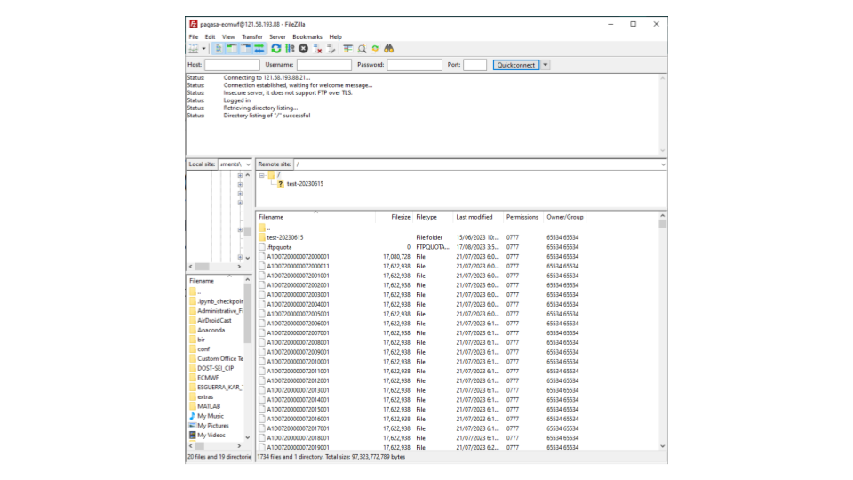
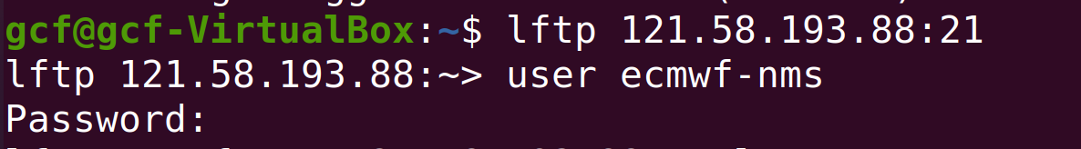
ECMWF DATA ACCESS
THRU FILEZILLA
THRU TERMINAL

Slide 13
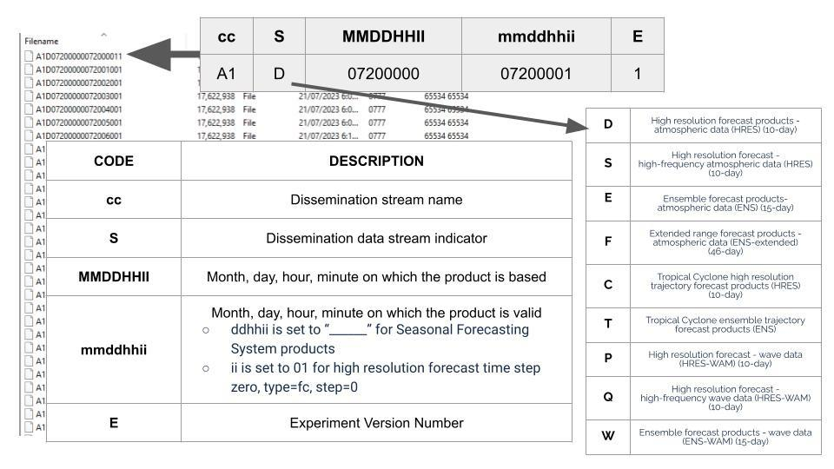

ECMWF DATA FILENAME

Slide 14
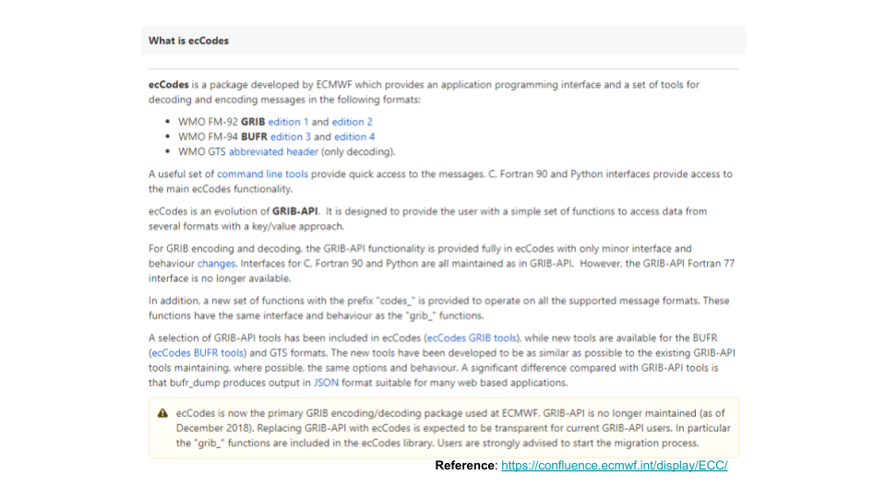
POST PROCESSING

Slide 15
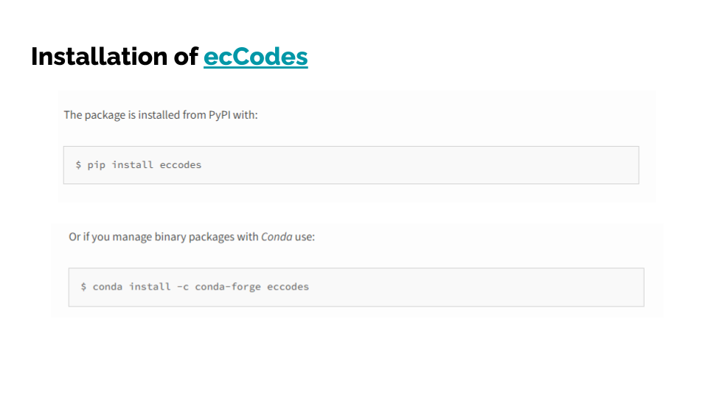
POST PROCESSING

Slide 16
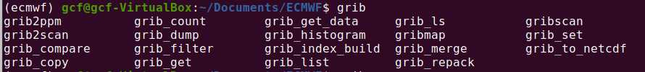
SAMPLE

Slide 17
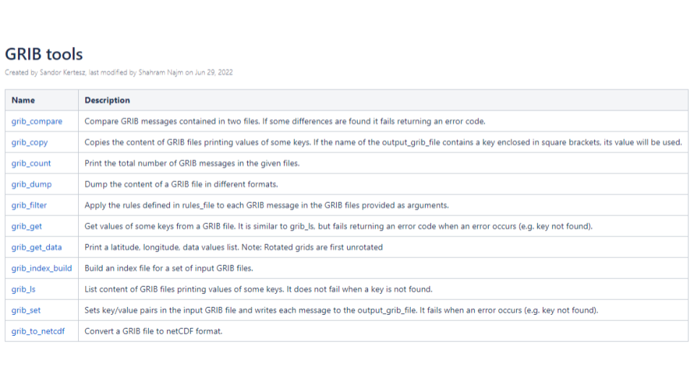
ECCODE TOOLS

Slide 18
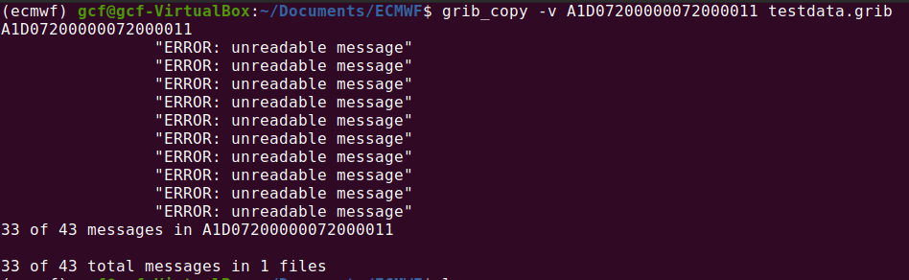
SAMPLE

Slide 19
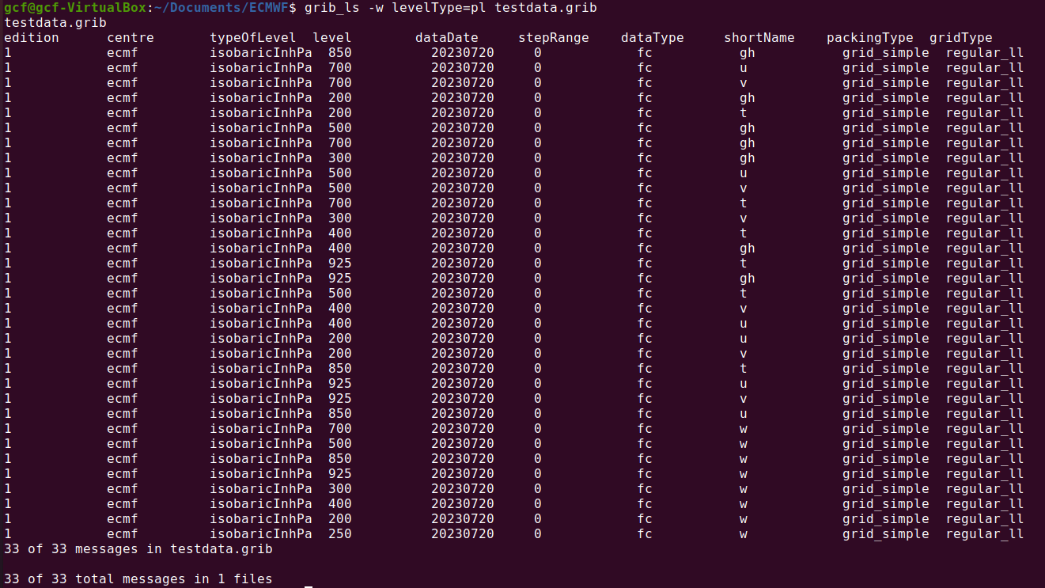
SAMPLE

Slide 20
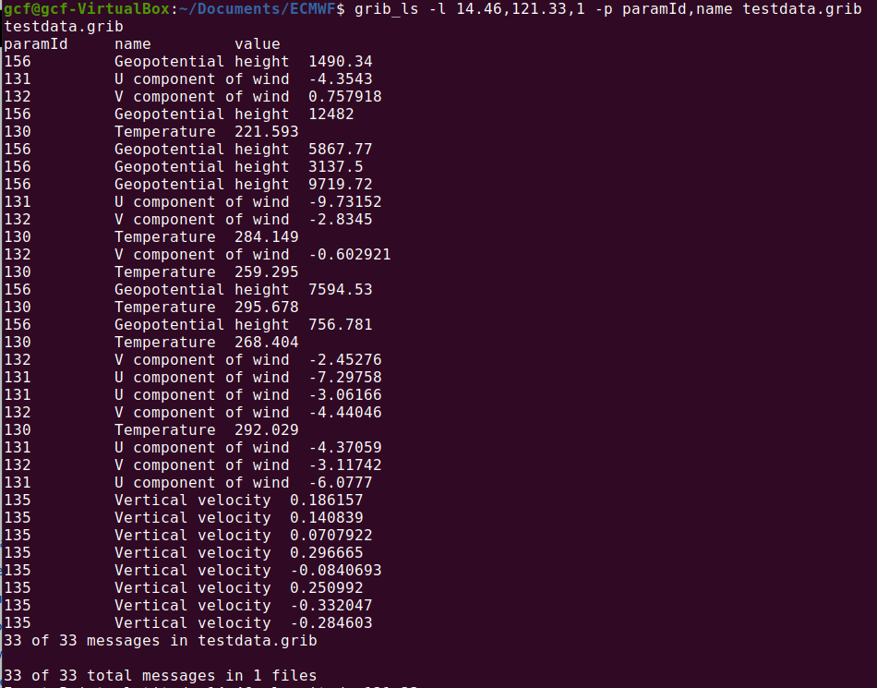
SAMPLE

Slide 21

POST PROCESSING
INSTALL WGRIB/WGRIB2 (CONDA)

Slide 22
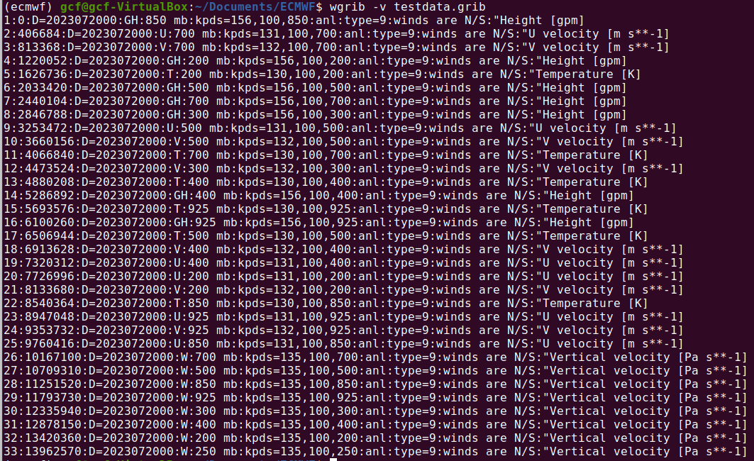
SAMPLE

Slide 23
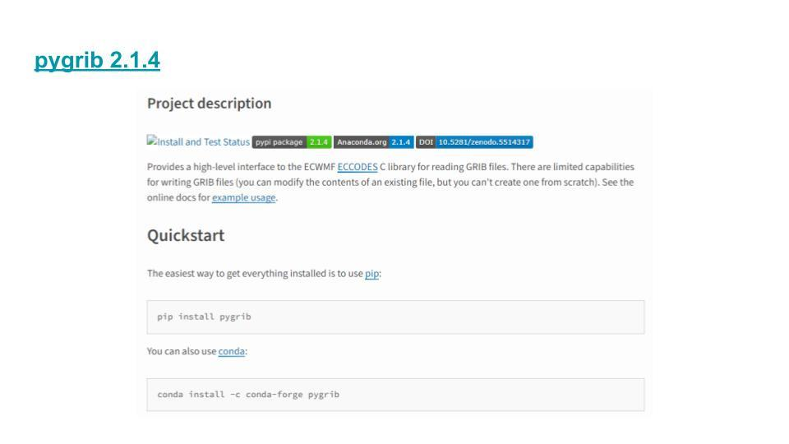
POST PROCESSING

Slide 24
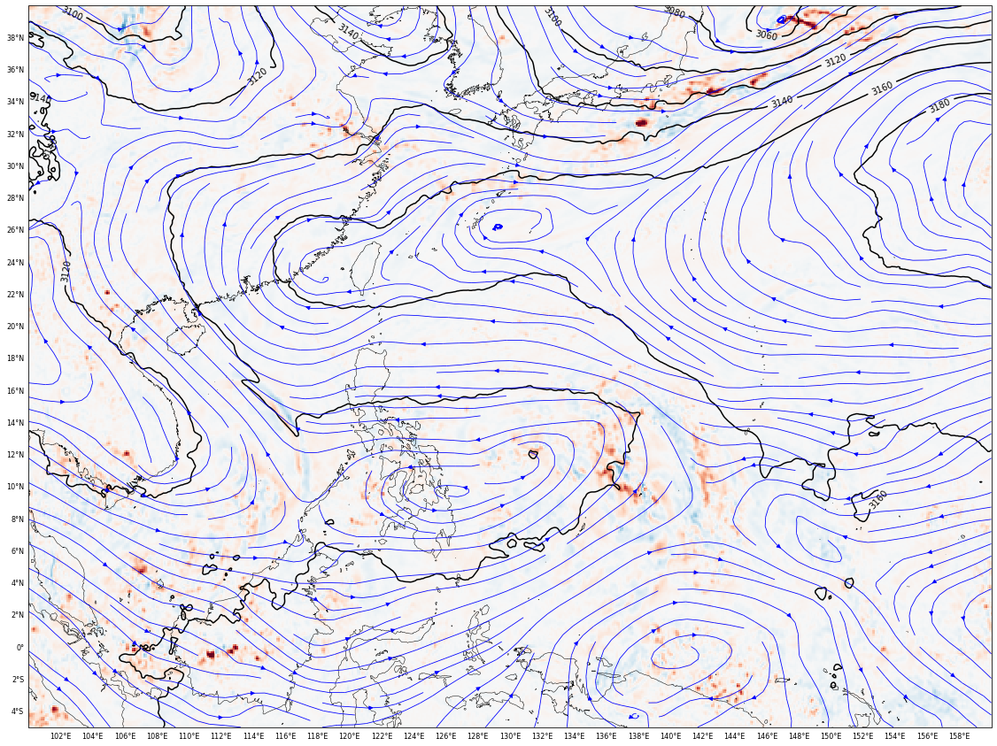
SAMPLE
SAMPLE PLOT USING PYGRIB PACKAGE SHOWING THE GEOPOTENTIAL HEIGHT, WIND AND POTENTIAL TEMPERATURE AT 700 MB

Slide 25


THANK YOU!
Got any queries?
kesguerra22@gmail.com or kaesguerra.gcf.pagasa@gmail.com

